Slide 1
Chapter 13:
Overloading- PART II

Slide 2
Objectives
In this chapter, you will
  Learn about friend functions
  Learn how to overload operators as non-friend functions
  Learn about overloading rules
  Become familiar with the requirements for classes with pointer member variables
C++ Programming: From Problem Analysis to Program Design, Seventh Edition

Slide 3
Overloading Unary and Binary Operators
If unary and binary operators are overloaded using member functions:
  Unary operators have no parameters
  Binary operators have only one parameter
C++ Programming: From Problem Analysis to Program Design, Seventh Edition

Slide 4
Operator Overloading as Friend Functions
C++ Programming: From Problem Analysis to Program Design, Seventh Edition

Slide 5
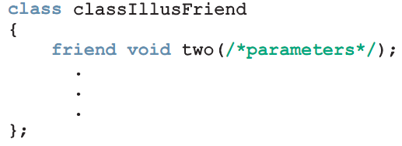
Friend Functions of Classes
Friend function (of a class): a nonmember function of the class that has access to all the members of the class
Use the reserved word friend in the function prototype in the class definition
C++ Programming: From Problem Analysis to Program Design, Seventh Edition

Slide 6
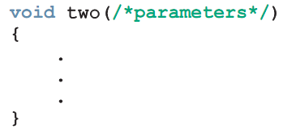
Definition of a friend Function
When writing the friend function definition
  The name of the class and the scope resolution operator are not used
  "friend" doesn’t appear in function definition
C++ Programming: From Problem Analysis to Program Design, Seventh Edition

Slide 7
Operator Functions as Member and Nonmember Functions
If op is overloaded for opOverClass:
  If the leftmost operand of op is an object of a different type, the overloading function must be a nonmember (friend) of the class
  If the overloading function for op is a member of opOverClass, then when applying op on objects of type opOverClass, the leftmost operand must be of type opOverClass
C++ Programming: From Problem Analysis to Program Design, Seventh Edition

Slide 8
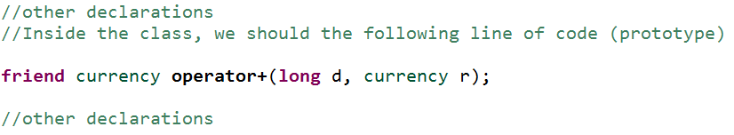
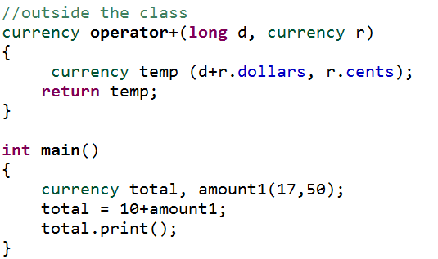
Overloading as Friend Functions: Addition with Constant Value
Example: 10+amount1
OUTPUT
C++ Programming: From Problem Analysis to Program Design, Seventh Edition

Slide 9
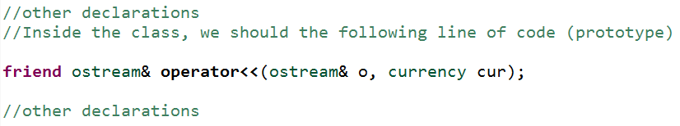
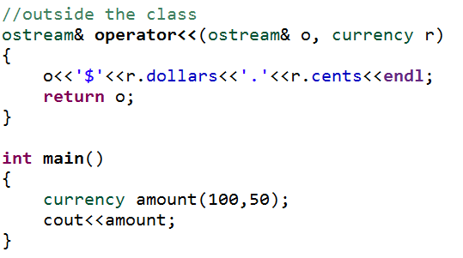
Overloading as Friend Functions: Insertion Operator (<<)
Overloading insertion operator (<<)
OUTPUT
C++ Programming: From Problem Analysis to Program Design, Seventh Edition

Slide 10
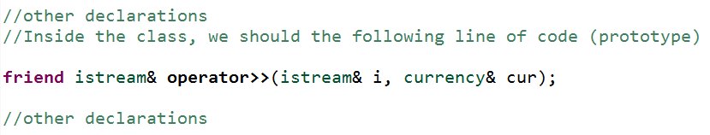
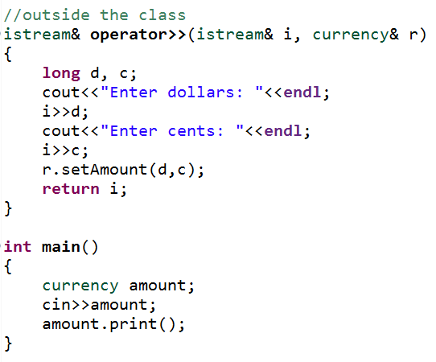
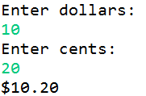
Overloading as Friend Functions: Extraction Operator >>
Overloading extraction operator (>>)
OUTPUT
C++ Programming: From Problem Analysis to Program Design, Seventh Edition

Slide 11
Overloading Binary Operators
Member binary operator (e.g., + or ==) can be overloaded as a friend function with two parameters
Member unary operator can be overloaded as a friend function with one parameter.
C++ Programming: From Problem Analysis to Program Design, Seventh Edition

Slide 12

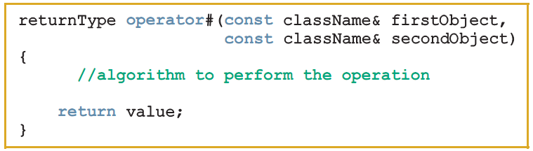
Overloading the binary Arithmetic or Relational Operators as Nonmember Functions
Function prototype (included in class definition):
Function definition:
C++ Programming: From Problem Analysis to Program Design, Seventh Edition

Slide 13
Operator Overloading as Non-Friend and Non-Member Functions
C++ Programming: From Problem Analysis to Program Design, Seventh Edition

Slide 14
Overloading Operators as Non-Friend and Non-Member Function
We can overload an operator with a function that is not member and not a friend of the class
We can use this way for overloading when there is no need to access private members
C++ Programming: From Problem Analysis to Program Design, Seventh Edition

Slide 15
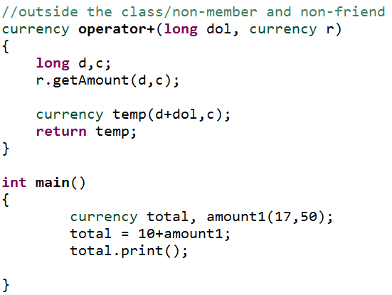
Overloading Operators as Non-Friend and Non-Member Function [cont]
OUTPUT
C++ Programming: From Problem Analysis to Program Design, Seventh Edition

Slide 16
Classes and Pointer Member Variables (Revisited)
Recall that assignment operator copies member variables from one object to another of the same type
  Does not work well with pointer member variables
Classes with pointer member variables must:
  Explicitly overload the assignment operator
  Include the copy constructor
  Include the destructor
C++ Programming: From Problem Analysis to Program Design, Seventh Edition

Slide 17
Overloading Rules
We cannot create new operators
We cannot change the basic meaning of an operator (we cannot redefine the plus(+) operator to subtract one value from other
The overloaded operator must have at least one operand that is of user-defined type
We cannot overload: . .* :: ?: sizeof
We cannot use friend functions to overload certain operators however member functions can be used to overload them: = () [] ->
Cannot change precedence or associativity
Default parameters cannot be used
Cannot change number of parameters
C++ Programming: From Problem Analysis to Program Design, Seventh Edition

Slide 18
THE END
C++ Programming: From Problem Analysis to Program Design, Seventh Edition

